Slide 1
What is Brand Equity?

Slide 2
Overview
Brand equity definitions
Brands as assets
Brand valuation
Impact of brand equity

Slide 3
Two Definitions of Brand Equity
“The added value to the firm, the trade, or the consumer, with which a given brand name endows the product.”
“The difference between the value of the brand to the consumer and the value to the consumer of the product without that branding.”

Slide 4
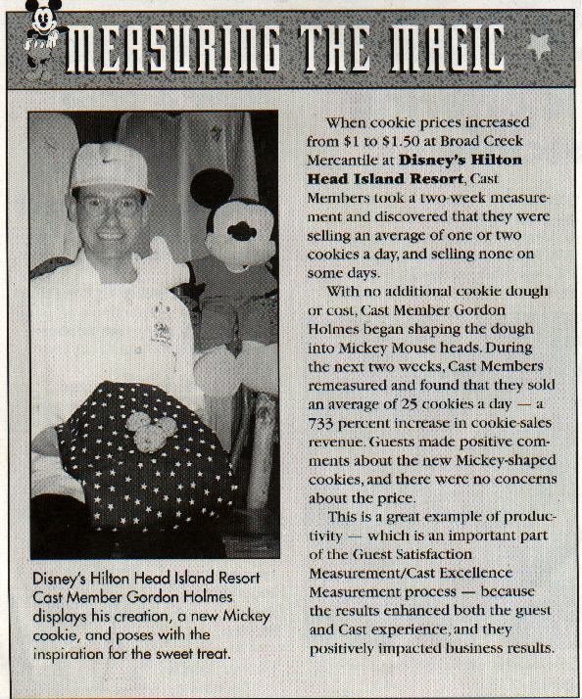
Brand Equity at Work
733% INCREASE IN COOKIE SALES!

Slide 5
Brands as Assets (from Aaker on Branding, 2014)
Tactical to strategic perspective
Emphasizes importance of marketing
Focus on brand equity
From single brands to brand families
Breaking down organizational silos
Brand manager “culture” needed

Slide 6
The Most Valuable Global Brands—2023*
Apple $502B
Microsoft $317B
Amazon $277B
Google $260B
Samsung $91B
Toyota $65B
Mercedes-Benz $61B
Coca-Cola $58B
Nike $54B
BMW $51B
*As estimated by Interbrand

Slide 7
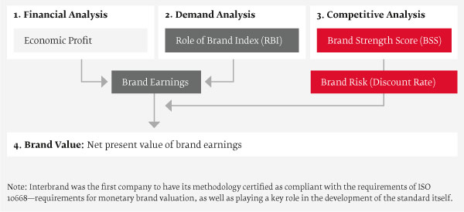
Interbrand’s Brand Valuation Model

Slide 8
Financial Analysis
Economic Profit
  After-tax brand profit
  Subtract a capital charge for all facilities and other capital used in the manufacture and sale of the brand
  Project a five-year profit forecast

Slide 9
Demand Analysis
Role of Brand Index (RBI)
  Estimate percent of purchase decision driven by the brand
  Largely category-based
  Estimate derived through research

Slide 10
Competitive Analysis
Brand Strength Score (BSS)
  Ranges from 0 to 100
  Ability to command loyalty
  Ten internal and external factors considered
  Proprietary formula links BSS to:
Brand Risk (discount rate)

Slide 11
BSS Factors
Internal
  Clarity
  Commitment
  Protection
  Responsiveness
External
  Authenticity
  Relevance
  Differentiation
  Consistency
  Presence
  Understanding

Slide 12
Brand Value
Net present value of projected brand earnings
Some 2020 Estimated Brand Values…and for 2023:
  Apple $323 billion $502 billion
  Amazon $201 billion $277 billion
  Google $165 billion $260 billion
  Coca-Cola $57 billion $58 billion

Slide 13
Brand Valuation Cautions
Reliance on over-simplified assumptions
Many subjective judgments
Tend to underestimate potential effects of long-term investments in R&D and advertising
Sometimes confound company strength and brand strength

Slide 14
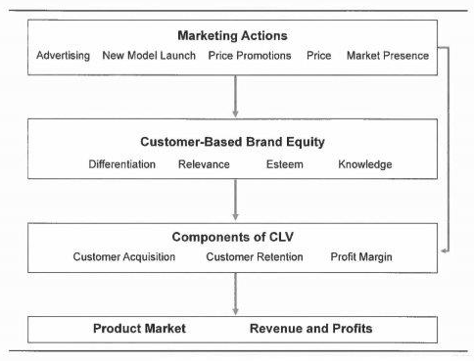
Impact of Brand Equity

Slide 15
Results of Empirical Study
39 auto brands (97% of market) over 10-year period
Marketing Actions affect CBBE components
  Advertising affects all but Knowledge
  Market Presence affects all but Esteem
CBBE affects the components of Customer Lifetime Value (CLV)
  Differentiation affects all three (but only Profit Margin positively)
  Knowledge affects all three
  Relevance affects Customer Acquisition
  Esteem affects Customer Retention

Slide 16
Conclusion
Does your organization estimate its brand(s) value?
Does your organization assess the impact of its brand(s) on profitability?
How well does your organization/brand adapt to changing market conditions?

Slide 17
End of Lecture

